Slide 1
Secure Operating Stuff
Lesson “like” 7 (a): Virtualization

Slide 2
Virtualization
Because of the hype around “the cloud”, virtualization has become pretty big news
However, virtualization is something we really need to understand if we want to reason about host and OS :P security

Slide 3
What is Virtualization?
Type 1 Hypervisor
  “native”, “bare metal”
Type 2 Hypervisor
  “hosted”

Slide 4
Paravirtualization
Instead of modifying all the IO to run through the Hypervisor, we can modify the hosted OS to use specific calls for IO
  Think of this as collaborative virtualization, in essence (hosted OS “collaborates” to take part in the illusion)

Slide 5
How?
There are really only three different routes to machine virtualization…
  How would you do it?
  What problems do we need to think about?

Slide 6
Hardware Assistance
Intel and AMD have extended their instruction set to provide hardware support for virtualization
  The Intel VT-I and VT-x instruction sets are powerful, and create a very capable platform
  I have no comment on the AMD instructions, as I am less familiar with them

Slide 7
Possible Threat: SubVirt
Theoretically (and in practice) you could make malware which threw the entire host OS into a VM
  Benefits?
  Disadvantages?

Slide 8
Detecting a VM Rootkit?
One basic tenet…

Slide 9
The Presence of Covert Channels
What is a covert channel?
  Lampson: a channel “not intended for information transfer at all, such as the service program’s effect on system load”

Slide 10
Five Concerns from Bratus et al.
Weaknesses in remote management
Increase in management cost (the VM and the host)
Creeping Guest to Host APIs
Information Flow Policy (see “Virtual Machines, Virtual Security”)
Conflation of two issues – the provider and the monitor…

Slide 11
Virtual Machine, Virtual Security?
This is really a nice little article that forces you to think about isolation – if we split everything up, we need to make holes to use the systems…
How many OS vulns really relied on exploits of the privilege system? How many relied on incorrect privileges?

Slide 12
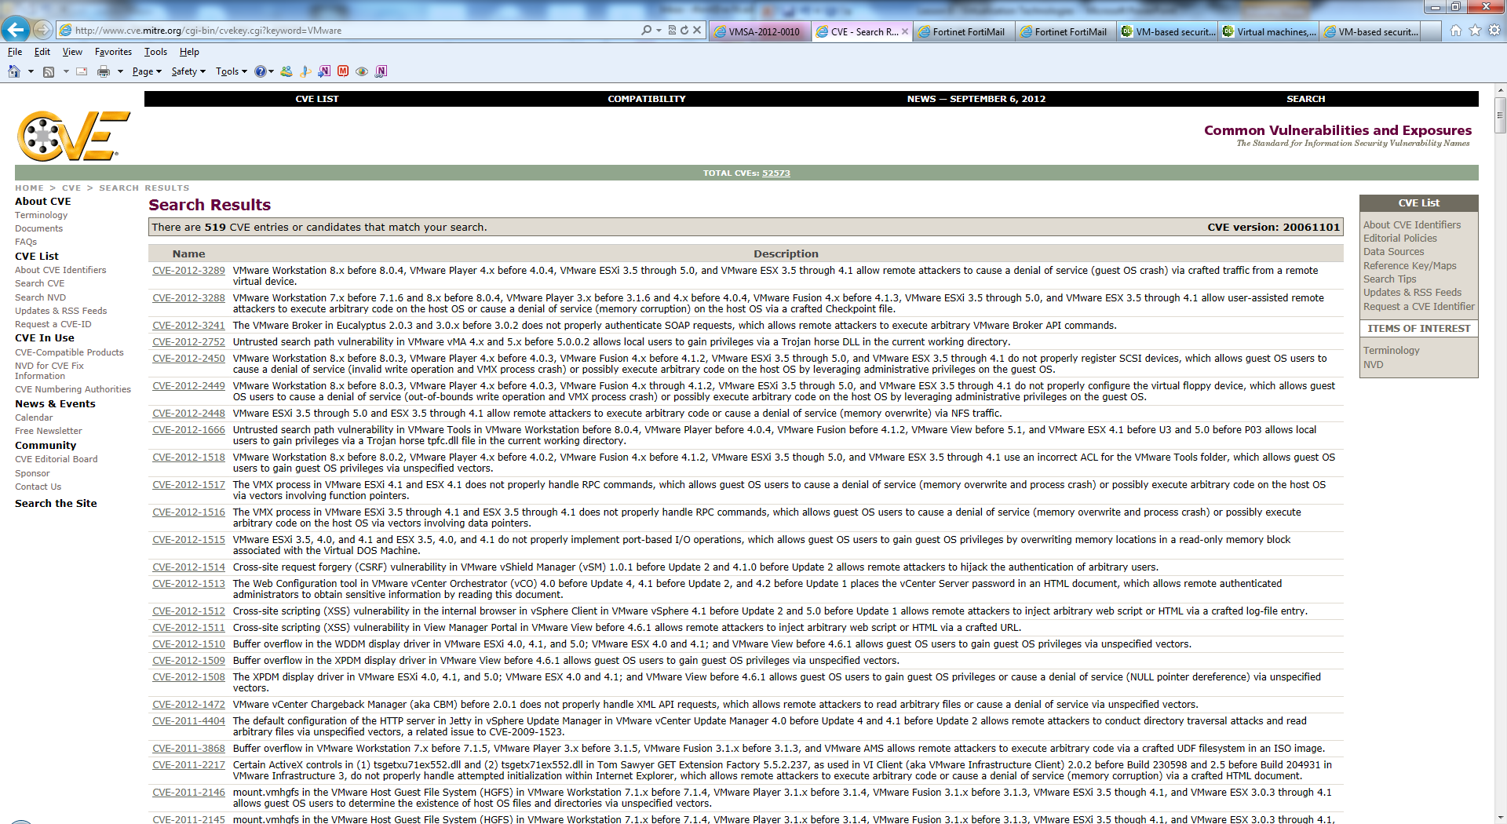
Why do we think we can do this?

Slide 13
With that said…
Virtualization Can Help
  Malware Analysis
  Rollback/trusted monitor
  “Disposable” computing

Slide 14
But also…
Virtualization Can Hurt
  Rootkits
  Covert Channels
  Escape from the VMM

Slide 15
To Do
If you’re interested (will help but is not required reading – good reference) read “Intel Virtualization Technology: Hardware Support for Efficient Processor Virtualization”
For the exam, must read “VM-based security overkill: a lament for applied systems security research” and (the very short) “Virtual Machines, Virtual Security”

